Slide 1
﻿An End-to-End Automatic Cloud Database Tuning System Using Deep Reinforcement Learning
夏浚洋
2021-01-06
Notes:
大家好，我本次汇报的论文是﻿An End-to-End Automatic Cloud Database Tuning System Using Deep Reinforcement Learning
我的提问是
1本文所提出的端到端数据库调优系统的特点是？
利用深度确定性策略梯度法来寻找高维连续空间中的最优配置。
采用试错策略，用有限的样本学习旋钮设置来完成初始训练，这就减轻了收集大量高质量样本的困难。
采用RL中的奖励反馈机制代替了传统的回归，实现了端到端的学习，加快了我们模型的收敛速度，提高了在线调优的效率。
2本文所使用的深度强化学习算法是什么？
DDPG
In this paper, we proposed an end-to-end automatic DBMS configuration tuning system CDBTune that can recommend superior knob settings in the complex cloud environment. CDBTune used a try-and-error manner in RL to learn the best settings with limited samples. Besides, our designed reward function can effectively improve tuning efficiency and the DDPG algorithm can find the optimal configurations in high-dimensional continuous space. Extensive experimental results showed that CDBTune produced superior configurations for various workloads that greatly improved performance with higher throughput and lower latency compared with the state-of-the-art tuning tools and DBA experts. We also demonstrated CDBTune had a good adaptability whenever the operating environment changed.
本文提出了一种端到端的自动DBMS配置调优系统CDBTune，可以在复杂的云环境中推荐优秀的旋钮设置。CDBTune采用RL中的试错方式，在有限的样本中学习最佳设置。此外，设计的奖励函数可以有效提高调优效率，DDPG算法可以在高维连续空间中找到最优配置。大量的实验结果表明，与最先进的调优工具和DBA专家相比，CDBTune为各种工作负载产生了优越的配置，极大地提高了性能，具有更高的吞吐量和更低的延迟。证明了CDBTune具有良好的适应性，每当运行环境发生变化时，CDBTune都能适应。

Slide 2
Outline
Introduction
System Overview
RL In CDBTune
DDPG For CDBTune
Experimental Study
Conclusion
Notes:
本次汇报将从以下6个方面展开

Slide 3
Introduction
Notes:
Configuration tuning is vital to optimize the performance of database management system (DBMS). It becomes more tedious and urgent for cloud databases (CDB) due to the diverse database instances and query workloads, which make the database administrator (DBA) incompetent. Although there are some studies on automatic DBMS configuration tuning, they have several limitations.
配置调优对于优化数据库管理系统（DBMS）的性能至关重要。对于云数据库（CDB）来说，由于数据库实例和查询工作负载的多样化，因此调优变得更加繁琐和迫切，并且使得数据库管理员（DBA）无法胜任。虽然有一些关于DBMS自动配置调优的研究，但它们有一些局限性。

Slide 4
Limitations of ﻿automatic DBM configuration tuning
Can not optimize the overall performance in an end-to-end manner
Rely on large-scale high quality training samples which are hard to obtain
A large number of knobs cannot recommend reasonable configrations in high-dimensional continuous space
Can hardly cope with the changes of hardware configuration and workloads, and have poor adaptability
Notes:
Firstly, they adopt a pipelined learning model but cannot optimize the overall performance in an end-to-end manner.
首先，他们采用的是流水线式的学习模型，但无法对整体性能进行端到端的优化。
Secondly, they rely on large-scale high-quality training samples which are hard to obtain.
第二，他们依赖于大规模高质量的训练样本，而这些样本很难获得。
Thirdly, there are a large number of knobs that are in continuous space and have unseen dependencies, and they cannot recommend reasonable configurations in such high-dimensional continuous space.
第三，大量的旋钮处于连续空间中，且具有不可见的依赖性，无法在这种高维连续空间中推荐合理的配置。
Lastly, in cloud environment, they can hardly cope with the changes of hardware configurations and workloads, and have poor adaptability.
最后，在云环境下，难以应对硬件配置和工作负载的变化，适应性差。

Slide 5
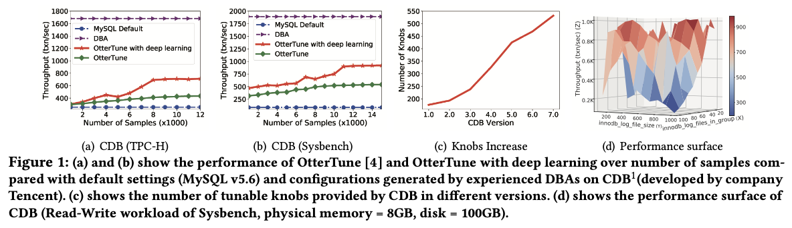
Limitations of ﻿automatic DBM configuration tuning
Notes:
As shown in Figures 1(a) and 1(b), without high-quality samples, OtterTune [4] or OtterTune with deep learning (we reproduce OtterTune and improve its pipelined model using deep learning) can hardly gain higher performance even though provided with an increasing number of samples.
如图1(a)和图1(b)所示，在没有高质量样本的情况下，即使提供越来越多的样本，OtterTune[4]或带深度学习的OtterTune，也很难获得更高的性能。
in practice there are a large number of knobs as shown in Figure 1(c). They cannot optimize the knob settings in high-dimensional continuous space by just using regression method like the Gaussian Process (GP) regression OtterTune used, because the DBMS configuration tuning problem that aims to find the optimal solution in continuous space is NP-hard [4].
在实际工作中，有大量的旋钮，如图1(c)所示，他们不能只用高斯过程(GP)这样的回归方法来优化高维连续空间的旋钮设置。因为以在连续空间中寻找最优解为目标的DBMS配置调整问题是NP-hard的[4]。
Moreover, the knobs are in continuous space and have unseen dependencies. As shown in Figure 1(d), due to nonlinear correlations and dependencies between knobs, the performance will not monotonically change in any direction. Besides, there exist countless combinations of knobs because of the continuous tunable parameters.
此外，旋钮处于连续空间中，且具有不可见的依赖性。如图1(d)所示，由于旋钮之间的非线性相关性和依赖性，性能不会向任何方向单调变化。此外，由于连续的可调参数，存在无数的旋钮组合，如图1(d)所示。

Slide 6
CDBTune: an end-to-end automatic CDB tuning system
Using deep reinforcement learning
Adopting a try-and-error strategy to accomplish the initial training
Adopting the reward-feedback mechanism in RL instead of traditional regression, which enables end-to-end learning and accelerates the convergence speed of model and
Notes:
To address these challenges, we design an end-to-end automatic CDB tuning system, CDBTune, using deep reinforcement learning (RL).
为了解决这些难题，我们利用深度强化学习（RL）设计了一个端到端的CDB自动调优系统CDBTune。
CDBTune utilizes the deep deterministic policy gradient method to find the optimal configurations in high-dimensional continuous space.
CDBTune利用深度确定性策略梯度法来寻找高维连续空间中的最优配置。
CDBTune adopts a try-and-error strategy to learn knob settings with a limited number of samples to accomplish the initial training, which alleviates the difficulty of collecting massive high-quality samples.
CDBTune采用试错策略，用有限的样本学习旋钮设置来完成初始训练，这就减轻了收集大量高质量样本的困难。
CDBTune adopts the reward-feedback mechanism in RL instead of traditional regression, which enables end-to-end learning and accelerates the convergence speed of our model and improves efficiency of online tuning.
CDBTune采用RL中的奖励反馈机制代替了传统的回归，实现了端到端的学习，加快了我们模型的收敛速度，提高了在线调优的效率。
We conducted extensive experiments under 6 different workloads on real cloud databases to demonstrate the superiority of CDBTune. Experimental results showed that CDBTune had a good adaptability and significantly outperformed the state-of-the-art tuning tools and DBA experts.
在6种不同的工作负载下对真实的云数据库进行了大量的实验，以证明CDBTune的优越性。实验结果表明，CDBTune具有良好的适应性，明显优于最先进的调优工具和DBA专家。

Slide 7
Two classes of representative studies in DBMS configuration tuning
The search-based methods
Search the optimal parameters based on certain given principles
Two limitations
Spend a great amount of time on searching the optimal configurations
Restart the searching processing whenever a new request comes, and thus fail to utilize the knowledge gained from previous tuning efforts
The learning-based methods
Utilize machine-learning techniques to collect, process and analyze knobs and recommend possible settings by learning DBA’s experiences from historical data
Four limitations

Slide 8
System Overview
Working mechanism and architecture of CDBTune
Notes:
In this section, we present our end-to-end automatic cloud database tuning system CDBTune using deep RL. We firstly introduce the working mechanism of CDBTune (Section 2.1) and then present the architecture of CDBTune (Section 2.2).
在本节中，将介绍使用深度RL的端到端自动云数据库调优系统CDBTune。首先介绍CDBTune的工作机制，然后介绍CDBTune的架构

Slide 9
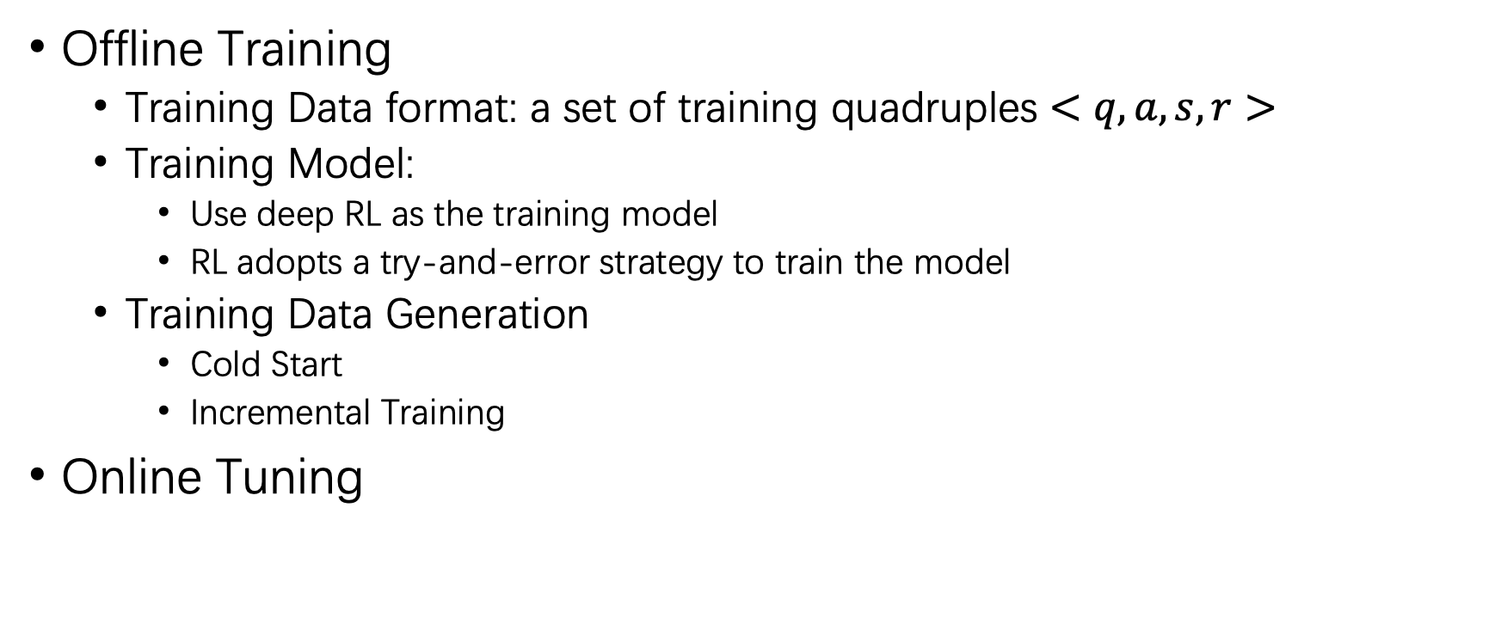
CDBTune Working Mechanism
Offline Training
Training Data format: a set of training quadruples $<q, a, s, r>$
Training Model:
Use deep RL as the training model
RL adopts a try-and-error strategy to train the model
Training Data Generation
Cold Start
Incremental Training
Online Tuning
Notes:
CDBTune的工作流程分为两部分，首先是离线训练，虽然系统需要离线训练。但它只训练一次模型，之后即可使用模型进行在线调优
Training Data
The training data is a set of training quadruples ⟨q,a,s,r⟩, where q is a set of query workloads (i.e., SQL queries), a is a set of knobs as well as their values when processing q, s is the database state (which is a set of 63 metrics) when processing q, r is the performance when processing q (including throughput and latency).
所需的训练数据是一组四元组⟨q,a,s,r⟩，其中q是一组查询工作负载(即SQL查询)，a是一组旋钮以及处理q时的值，s是处理q时的数据库状态(这是一组63个指标)，r是处理q时的性能(包括吞吐量和延迟)。
Training Model
Because the DBMS configuration tuning problem that aims to find the optimal solution in continuous space is NP-hard [4], we use deep RL as the training model. RL adopts a try-and-error strategy to train the model, which explores more optimal configurations that the DBA never tried, reducing the possibility of falling in local optimum. Note the RL model is trained once offline which will be used to tune the database knobs for each tuning request from database users.
由于以在连续空间中寻找最优解为目标的DBMS配置调整问题属于NP-hard，因此我们采用深度RL作为训练模型。RL采用试错策略来训练模型，可以探索更多DBA从未尝试过的最优配置，减少落在局部最优的可能性。需要注意的是，RL模型需要离线训练一次，然后用于处理数据库用户的每次调优请求，对数据库旋钮进行调整。
Training Data Generation
There are two ways to collect the training data. (1) Cold Start. Because of lacking historical experience data at the beginning of the offline training process, we utilize standard workload testing tools (such as Sysbench) to generate a set of query workloads. Then for each query workload q, we execute it on CDB and get the initial quadruple. Then we use the above try-and-error strategy to train the quadruple and get more training data. (2) Incremental Training. During the later practical use of CDBTune, for each user tuning request, our system continuously gains feedback information from the user request according to configurations CDBTune recommends. With adding more real user behavior data to the training process gradually, CDBTune will further strengthen the model and improve the recommendation accuracy of the model.
收集训练数据的方法有两种。
(1)冷启动。由于在离线训练过程开始时缺乏历史经验数据，我们利用标准的工作负载测试工具(如Sysbench)生成一组查询工作负载。然后在CDB上执行每个工作负载，得到初始的四元组。然后使用上述试错策略对四元组进行训练，得到更多的训练数据。
(2)增量训练。在CDBTune后期的实际使用过程中，对于每一个用户的调整请求，我们的系统都会根据CDBTune推荐的配置，不断获取用户请求的反馈信息。随着在训练过程中逐步加入更多的真实用户行为数据，CDBTune将进一步强化模型，提高模型的推荐精度。
Online Tuning
If a user wants to tune her database, she just needs to submit a tuning request to CDBTune which is in line with existing tuning tools like OtterTune and BestConfig. Once receiving an online tuning request from a user, CDBTune collects the query workload q from the user in recent about 150 seconds, gets the current knob configuration a, and executes the query workload in CDB to generate the current state s and performance r. Next it uses the model obtained by offline training to do online tuning. Eventually, those knobs corresponding to the best performance in online tuning will be recommended to the user.
如果用户想对自己的数据库进行调优，只需要向CDBTune提交调优请求，这与现有的调优工具如OtterTune和BestConfig是一致的。一旦收到用户的在线调优请求，CDBTune就会收集用户最近约150秒的查询工作量q，得到当前的旋钮配置a，并在CDB中执行查询工作量，生成当前的状态s和性能r，接下来就利用离线训练得到的模型进行在线调优。最终，将在线调优中对应最好性能的那些旋钮推荐给用户。

Slide 10
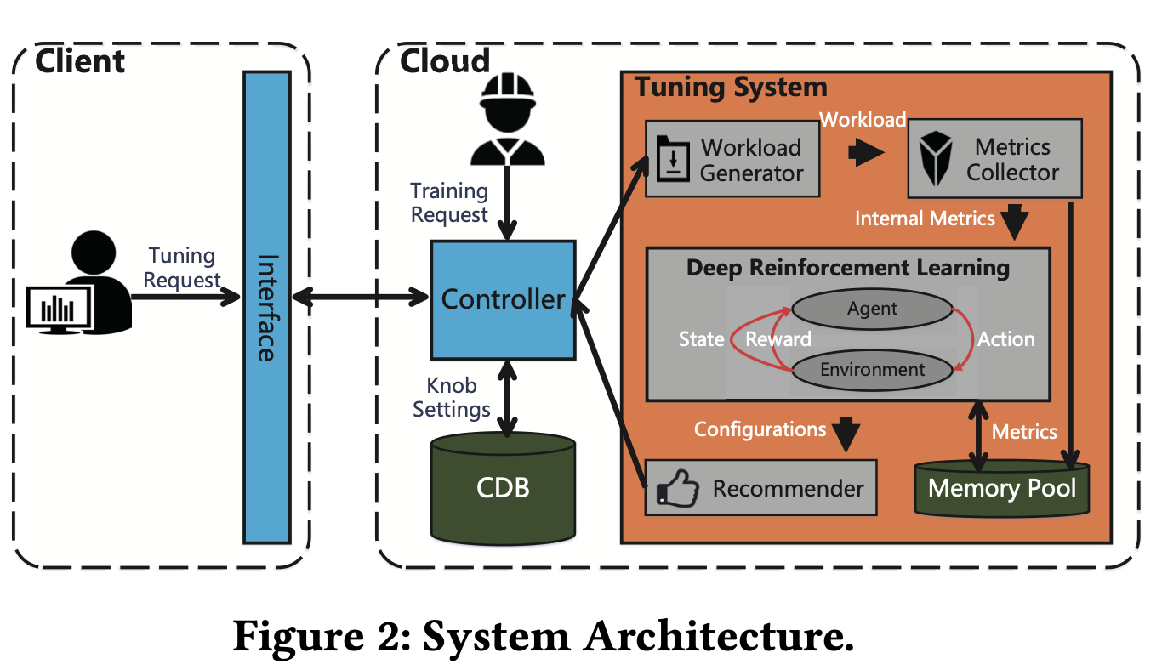
System Architecture
Notes:
Figure 2 illustrates the architecture of CDBTune. The dotted box on the left represents the client, where users send their own requests to the server through the local interface. The other dotted box represents our tuning system in cloud, in which the controller under distributed cloud platform interacts information among the client, CDB and CDBTune. When the user initiates a tuning request or the DBA initiates a training request via the controller, the workload generator conducts stress testing on CDB’s instances which remain to be tuned by simulating workloads or replaying the user’s workloads. At the same time, the metrics collector collects and processes related metrics. The processed data will be stored in the memory pool and fed into the deep RL network respectively. Finally, the recommender outputs the knob configurations which will be deployed on CDB.
图2展示了CDBTune的架构。左边的虚线框代表客户端，用户通过本地接口向服务器发送自己的请求。另一个虚框代表我们在云端的调优系统，分布式云平台下的控制器在客户端、CDB和CDBTune之间进行信息交互。当用户发起调优请求或DBA通过控制器发起训练请求时，工作负载生成器通过模拟工作负载或重放用户的工作负载，对CDB尚待调优的实例进行压力测试。同时，度量收集器收集并处理相关度量。处理后的数据将被存储在内存池中，并分别输入到深度RL网络中。最后，推荐器输出旋钮配置，将部署在CDB上。
Workload Generator
From the description above, the workload generator we designed mainly completes two tasks: generating the standard workload testing and replaying the current user’s real workload.
从上面的描述来看，设计的工作负载生成器主要完成两个任务：生成标准工作负载测试和重放当前用户的真实工作负载。
Metrics Collector
When tuning CDB upon a tuning request, we will collect and process the metrics data which can capture more aspects of CDB runtime behavior in a certain time interval.
在接到调优请求后对CDB进行调优时，Metrics Collector会对指标数据进行收集和处理，这些数据可以捕捉到CDB在一定时间间隔内更多方面的运行行为。数据库的当前状态由63个指标表示，并以向量的形式反馈给深层RL模型。
Recommender
When the deep RL model outputs the recommended configurations, the recommender gener- ates corresponding execution setting parameter commands and sends the request of modifying configurations to the controller.
当深层RL模型输出推荐配置时，推荐器生成相应的执行设置参数命令，并向控制器发送修改配置的请求。
Memory Pool
we use the memory pool to store the training samples. Generally speaking, each experience sample contains four categories of information: the state of current database, the reward value calculated by reward function via external metrics, knobs of the database to be executed at , and the database’s state vector after executing the configurations.
内存池被用来存储训练样本。一般来说，每个样本包含四类信息：当前数据库的状态、奖励函数通过外部指标计算出的奖励值、要执行的数据库的旋钮 ，以及执行配置后数据库的状态向量。

Slide 11
RL IN CDBTUNE
Notes:
There are two classes of representative studies in DBMS configuration tuning: search-based methods [55] and learning- based methods
在DBMS配置调优方面有两类代表性的研究：基于搜索的方法[55]和基于学习的方法。
Both the search-based approach and the multistep learning- based approach suffer from some limitations, so we desire to design an efficient end-to-end tuning system. At the same time, we hope that our model can learn well with limited samples in the initial training and simulate the DBA’s train of thought as much as possible. Therefore, we tried the RL method.
基于搜索的方法和基于多步学习的方法都存在一定的局限性，所以希望设计一个高效的端到端调优系统。同时，希望这个模型能够在初始训练中，在有限的样本下，能够很好地学习，并尽可能地模拟DBA的思路。因此尝试了RL方法。
To simulate the try-and-error method that the DBA adopts and overcome the shortcoming caused by regression, we introduce RL which originates from the method of try-and- error in animal learning psychology and is a key technology to solve NP-hard problems of database tuning in continuous space.
RL源于动物学习心理学中的试错法，引入RL以模拟DBA采用的试错法，克服回归造成的缺点，是解决连续空间中数据库调优这一NP-hard问题的关键技术。

Slide 12
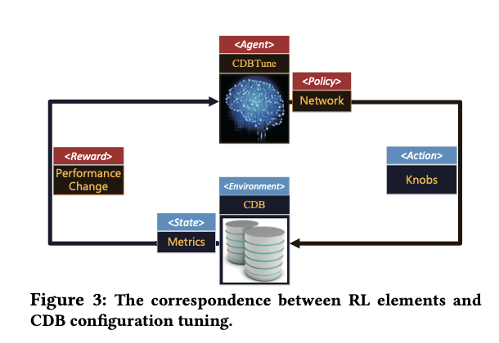
Basic Idea
Notes:
The main challenge of using RL in CDBTune is to map database tuning scenarios to appropriate actions in RL.
In Figure 3, we describe the interaction diagram of the six key elements in RL and show the correspondence between the six elements and database configuration tuning.
在CDBTune中使用RL的主要挑战是将数据库调优场景映射到RL中的适当动作。
在图3中，我们描述了RL中六个关键元素的交互图，并展示了六个元素与数据库配置调优之间的对应关系。
Agent: Agent can be seen as the tuning system CDBTune which receives reward (i.e., the performance change) and state from CDB and updates the policy to guide how to adjust the knobs for getting higher reward (higher performance).
Agent可以看作是调优系统CDBTune，它从CDB接收奖励（即性能变化）和状态，并更新策略，指导如何调整旋钮以获得更高的奖励（即更高的性能）
Environment: Environment is the tuning target, specifically an instance of CDB.
环境是调优目标，具体而言，即CDB的一个实例。
State: State means the current state of the agent, i.e., the 63 metrics. Specifically, when the CDBTune recommends a set of knob settings and CDB performs them, the internal metrics (such as counters for pages read to or written from disk collected within a period of time) represent the current state of CDB.
State是指agent的当前状态，即63个指标。具体来说，当CDBTune推荐一组旋钮设置并由CDB执行时，内部指标（如一段时间内收集到的从磁盘读取或写入的页面的计数器）代表CDB的当前状态。
Reward: Reward is a scalar described as rt which means the difference between the performance at time t and that at t − 1 or the initial settings, i.e., the performance change after/before CDB performed the new knob configurations that CDBTune recommended at time t.
奖励是一个标量，表示时间t与时间t-1或初始设置时的性能之差，即CDB在时间t执行CDBTune建议的新旋钮配置后/之前的性能变化。
Action: Action comes from the space of knob configurations, which is often described as at . Action here corresponds to a knob tuning operation. CDB performs the corresponding action according to the newest policy under the corresponding state of CDB. Note that an action is to increase or decrease all tunable knobs values at a time.
Action来自于旋钮配置的空间。这里的Action对应的是一个旋钮调整操作。CDB根据相应状态下的最新策略执行相应的操作。需要注意的是，一个动作是一次增加或减少所有可调谐旋钮的值。
Policy: Policy μ(st ) defines the behavior of CDBTune in certain specific time and environment, which is a mapping from state to action. In other words, given a CDB state, if an action (i.e., a knob tuning) is called, the policy keeps the next state by applying the action on the original state. The policy here is the deep neural network, which keeps the input (database state), output (knobs), and transitions among different states. The goal of RL is to learn the best policy. We will introduce the details of deep neural network in Section 4.
策略（Policy）是指CDBTune在特定时间和环境下的行为。定义了CDBTune在特定时间和环境下的行为，它是一个从状态到动作的映射。换句话说，给定一个CDB状态，如果调用了一个动作（即旋钮调优），策略通过在原始状态上应用动作来保持下一个状态。这里的策略是深度神经网络，它保留了输入（数据库状态）、输出（旋钮）以及不同状态之间的转换。RL的目标是学习最佳策略。
RL Working Process. The learning process of DBMS configuration tuning in RL is summarized as follows. CDB is the target that we need to tune, which can be regarded as the environment in RL, while the deep RL model in CDBTune is considered to be the agent in RL, which is mainly composed of deep neural network (policy) whose input is the database state and output is the recommended configurations corresponding to the state. When executing the recommended configurations on CDB, the current state of database will change, which is reflected in the metrics. Internal metrics can be used to measure the runtime behavior of database corresponding to the state in RL, while external metrics can evaluate the performance of database for calculating the corresponding feedback reward value in RL. Agent will update its network (policy) according to these two feedback information to recommend superior knobs. This process iterates until the model converges. Ultimately, the most appropriate knob settings will be exposed.
RL中DBMS配置调优的学习过程总结如下。CDB是我们需要调优的目标，可以看作是RL中的环境，而CDBTune中的深度RL模型则被认为是RL中的代理，它主要由深度神经网络（policy）组成，其输入是数据库状态，输出是与该状态对应的推荐配置。当在CDB上执行推荐配置时，数据库的当前状态会发生变化，这些变化会反映在指标上。内部指标可以用来衡量RL中数据库对应状态的运行时行为，外部指标可以评估数据库的性能，用于计算RL中相应的反馈奖励值。Agent会根据这两个反馈信息更新其网络（策略），推荐优胜的旋钮。这个过程反复进行，直到模型收敛。最终，得到最合适的旋钮设置。

Slide 13
DDPG FOR CDBTUNE
Notes:
In this section, we first introduce a policy-based RL method DDPG, then describe our designed reward function, and finally sum up the advantages of applying RL to the database tuning problem.
在本节中，我将首先介绍了一种基于策略的RL方法DDPG，然后描述了我们设计的奖励函数，最后总结了将RL应用于数据库调优问题的优势。

Slide 14

Deep Deterministic Policy Gradient
A policy-based method
Combination of DQN and actor-critic algorithm
Policy function: $a_{t}=μ\left(s_{t} | θ^{μ}\right)$
Critic function: $Q(s_{t}, a_t|θ^{Q})$
Notes:
Deep deterministic policy gradient (DDPG) [29] algorithm is a policy-based method. DDPG is the combination of DQN and actor-critic algorithm, and can directly learn the policy.
深度确定性策略梯度（DDPG）算法是一种基于策略的方法。DDPG是DQN和行为者批判算法的结合，可以直接学习策略。
In other words, DDPG is able to immediately acquire the specific value of the current continuous action according to the current state instead of computing and storing the corresponding Q-values for all actions, like DQN.
换句话说，DDPG能够根据当前的状态立即获取当前连续动作的具体值，而不是像DQN那样计算和存储所有动作的对应Q值。
Therefore, DDPG can learn the policy with high-dimensional states and actions, specifically, internal metrics and knob configurations.
因此，DDPG可以学习具有高维度状态和动作的策略，特别是内部指标和旋钮配置。

Slide 15
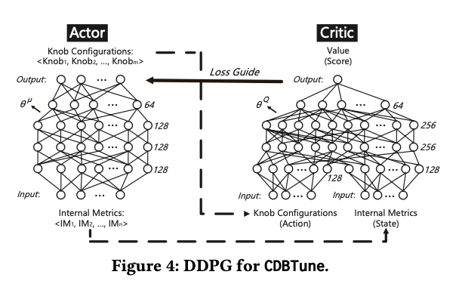
Main Steps of DDPG
Notes:
The algorithm contains seven main steps
Step 1. We first extract a batch of transition (st,rt,at,st+1) from the experience replay memory.
Step 2. We feed st+1 to the actor network and output the knob settings a′t+1 to be executed at next moment.
t+1 Step 3. We get the value (score) Vt+1 after sending st +1 and
a′t+1 to the critic network. t+1
Step 4. According to Q-Learning algorithm, Vt +1 is multi- plied by discount factor γ and added by the value of reward at time t, and now we can estimate the value of Vt′ of the current state st .
Step 5. We feed st (obtained at the first step) to the critic networkandfurtheracquirethevalueVt ofthecurrentstate.
Step 6. We compute the square difference between Vt′ and Vt andoptimizeparameterθQ ofthecriticnetworkbygradient descent.
Step 7. We useQ(s =st,μ(st)|θQ)outputtedbythecriticnet- work as the loss function, and adopt gradient descent means to guide the update of the actor network in order that the critic network gives a higher score for the recommendation outputted by the actor network each time.
图 4 中描述了 CDBTune 的 DDPG。当在CDBTune中利用DDPG时，首先，将有待调优的CDB的实例看作是一个环境E，调优代理可以在时间t从E中获得归一化的内部指标st，然后我们的调优代理生成旋钮设置at，并在实例上部署后将获得奖励。与大多数策略梯度方法类似，DDPG有一个参数化的策略函数。网络的批判函数旨在表示具有特定动作和状态的值（得分），从而指导行动者的学习。具体来说，critical函数有助于根据实例的当前状态评价actor产生的旋钮设置。
该算法包含七个主要步骤（伪代码总结在附录B.1中）。
第1步。我们首先从经验重放存储器中提取一批过渡（st,rt,at,st+1）。
步骤2.我们将st+1输入到行为记忆中。我们将st+1反馈给演员网络，并输出下一刻要执行的旋钮设置a′。
第三步。我们在发送st+1和
a′到批评家网络。
第四步：根据Q-Learning算法，将Vt+1由贴现因子γ多重填充，再加上时间t的奖励值，现在可以估计出当前状态st的Vt′值。根据Q-Learning算法，将Vt+1乘以折现因子γ，再加上时间t的奖励值，现在我们可以估计当前状态st的Vt′值。
第五步。我们将st（第一步得到的）反馈给批判网络，进一步获取当前状态的价值Vt。
第6步，我们计算Vt与Vt之间的平方差。我们计算Vt′和Vt之间的平方差，并通过梯度下降优化批评网络的参数θQ。
Step7.我们将批评网络输出的Q(s=st,μ(st)|θQ)作为损失函数，采用梯度下降的手段来引导行为网络的更新，以使批评网络每次对行为网络输出的推荐给出更高的分数。

Slide 16
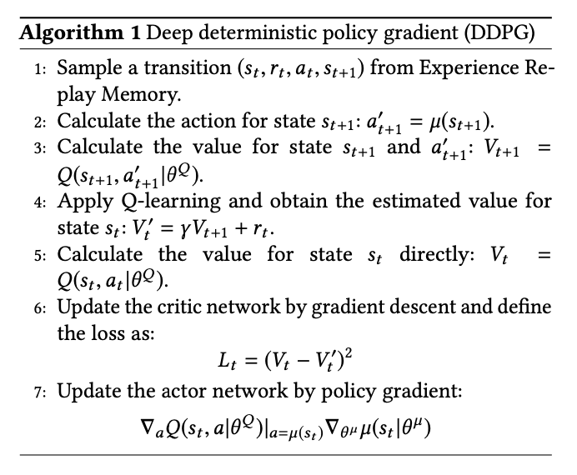
Main Steps of DDPG
Notes:
该算法包含七个主要步骤（伪代码总结在附录B.1中）。
第1步。我们首先从经验重放存储器中提取一批过渡（st,rt,at,st+1）。
步骤2.我们将st+1输入到行为记忆中。我们将st+1反馈给演员网络，并输出下一刻要执行的旋钮设置a′。
第三步。我们在发送st+1和
a′到批评家网络。
第四步：根据Q-Learning算法，将Vt+1由贴现因子γ多重填充，再加上时间t的奖励值，现在可以估计出当前状态st的Vt′值。根据Q-Learning算法，将Vt+1乘以折现因子γ，再加上时间t的奖励值，现在我们可以估计当前状态st的Vt′值。
第五步。我们将st（第一步得到的）反馈给批判网络，进一步获取当前状态的价值Vt。
第6步，我们计算Vt与Vt之间的平方差。我们计算Vt′和Vt之间的平方差，并通过梯度下降优化批评网络的参数θQ。
Step7.我们将批评网络输出的Q(s=st,μ(st)|θQ)作为损失函数，采用梯度下降的手段来引导行为网络的更新，以使批评网络每次对行为网络输出的推荐给出更高的分数。

Slide 17
Reward Function
Notes:
The reward function is vital in RL, which provides impactful feedback information between the agent and environment.
We desire that the reward can simulate the DBA’s empirical judgement for real environment in the tuning process.
奖励函数在RL中至关重要，它提供了代理和环境之间的影响反馈信息。
在调优过程中，奖励能够模拟DBA对真实环境的经验判断。

Slide 18
DBA’s tuning process
Suppose that the initial performance of DBMS is D0 and the final performance tuned by DBA is Dn .
DBA tunes the knobs and the performance becomes D1 after the first tuning. Then DBA computes the performance change ∆(D1, D0).
At the i-th tuning iteration, DBA expects that the current performance is better than that of the previous one (i.e., Di is better than Di−1 where i < n), because DBA aims to improve the performance through the tuning. However, DBA cannot guarantee Di is better than Di−1 at every iteration. To this end, DBA compares (a) Di and D0 and (b) Di and Di−1. If Di is better than D0, the tuning trend is correct and the reward is positive; otherwise the reward is negative. The reward value is calculated based on ∆(Di,D0) and ∆(Di,Di−1).

Slide 19
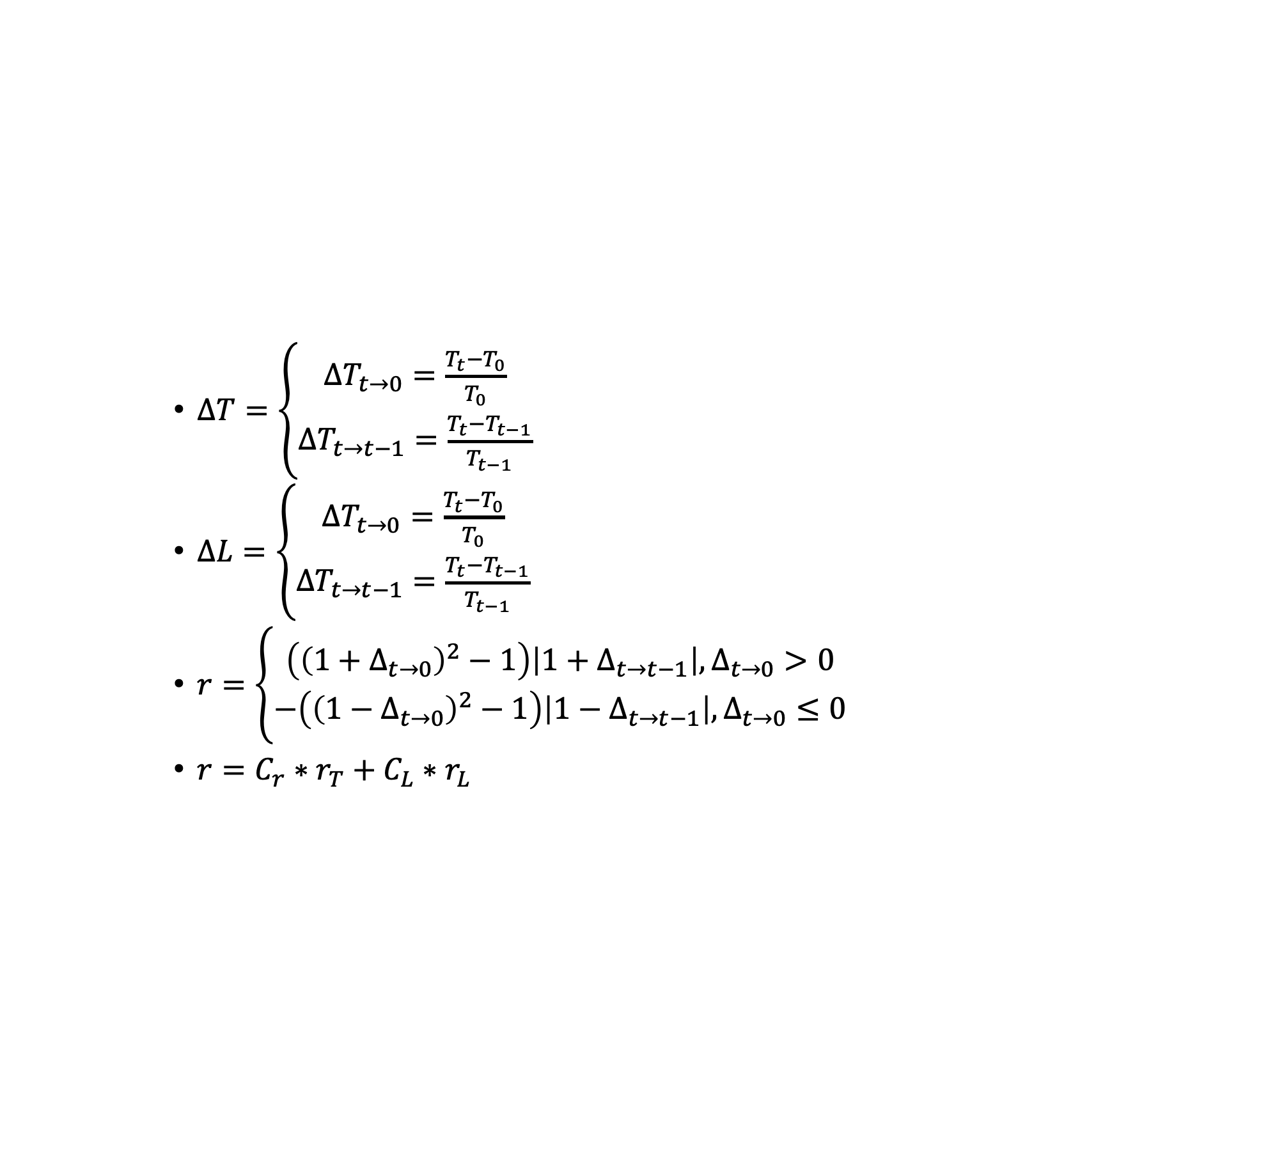

The rate of performance change
$∆T=\left\{\begin{aligned}∆T_{t→0}=\frac{T_{t}−T_{0}}{T_{0}} \\ ΔT_{t→t−1}=\frac{T_{t}−T_{t−1}}{T_{t−1}}\end{aligned}\right.$
$∆L=\left\{\begin{aligned}∆T_{t→0}=\frac{T_{t}−T_{0}}{T_{0}} \\ ΔT_{t→t−1}=\frac{T_{t}−T_{t−1}}{T_{t−1}}\end{aligned}\right.$
$r=\left\{\begin{aligned}\left({\left(1+Δ_{t→0}\right)}^{2}−1\right)\left|1+Δ_{t→t−1}\right|, Δ_{t→0}>0 \\ −\left({\left(1−Δ_{t→0}\right)}^{2}−1\right)\left|1−Δ_{t→t−1}\right|, Δ_{t→0}≤0\end{aligned}\right.$
$r=C_{r}∗r_{T}+C_{L}∗r_{L}$
$$T:throughput$$
$L:latency$
$r:reward$
Notes:
we model the tuning method of DBAs, which not only considers the change of performance at the previous time but also the initial time (when the database needs to be tuned). Formally, let r , T and L denote reward, throughput and latency.
Especially, T0 and L0 are respectively the throughput and latency before tuning. We design the reward function as follows.
At time t , we calculate the rate of performance change ∆ from time t − 1 and the initial time to time t respectively.
According to Eq. (4) and Eq. (5), we design the reward
function below:
According to the above steps we can calculate the rewards of throughput and latency rT and rL.
According to the above steps we can calculate the rewards of throughput and latency rT and rL. Then we multiply these two rewards by different coefficients CL and CT , where CL + CT = 1. Note that the coefficients can be set based on user preferences. We use r to denote the sum of rewards of throughput and latency
对DBA的调优方法进行建模时，不仅考虑了相对前一次的性能变化，还考虑了相对初始时间的性能变化（数据库需要调优时）。
在时间t ，分别计算从时间t - 1和初始时间到时间t的性能变化率∆，如图所示
式中，T和L表示奖励、吞吐量和延迟。T0和L0分别是调优前的吞吐量和延迟。
根据前两个公式，本文设计的奖励函数为下面的函数。
根据以上步骤，可以进一步计算出吞吐量和延迟的奖励rT和rL。然后将这两个奖励乘以不同的系数CL和CT ，其中CL + CT = 1。这些系数可以根据用户的实际情况来设置。吞吐量和延迟的奖励之和即为最终的奖励函数。

Slide 20
the sum of rewards of throughput and latency
Notes:
According to the above steps we can calculate the re- wardsofthroughputandlatencyrT andrL.Thenwemultiply these two rewards by different coefficients CL and CT , where CL + CT = 1. Note that the coefficients can be set based on user preferences. We use r to denote the sum of rewards of throughput and latency
If the goal of optimization is throughput and latency, our reward function does not need to change, because the reward function is independent to the hardware environment and workload changes, and it only depends on the optimization goal. Thus, the reward function needs to be redesigned only if the optimization goals are changed.

Slide 21
Advantages
The advantages of our method are summarized as follows.
Limited Samples
High-dimensional Continuous Knobs Recommendation
End-to-End Approach
Reducing the Possibility of Local Optimum
Good Adaptability
Notes:
he advantages of our method are summarized as follows.
Limited Samples. In the absence of high-quality empirical data, accumulating experience via try-and-error method re- duces the difficulty of data acquisition and makes our model generate diverse samples and learn towards an optimizing direction by using deep RL which can reasonably use lim- ited samples to achieve great effects.
High-dimensional Continuous Knobs Recommendation. The DDPG method can recommend a better configuration recommendation in high-dimensional continuous space than simple regression OtterTune used.
End-to-End Approach. The end-to-end approach reduces the error caused by multiple segmented tasks and improves the precision of recommended configu- ration. Moreover, the importance degree of different knobs is treated as an abstract feature which can be perceived and automatically accomplished by deep neural network instead of using an extra method to rank the importance degree of different knobs (see Section 5.2.2).
Reducing the Possi- bility of Local Optimum. CDBTune may not find the global optimum, but RL adopts the well-known exploration & ex- ploitation dilemma, which not only gives full play to the ability of the model, but also explores more optimal configu- rations that the DBA never tried, reducing the possibility of trapping in local optimum.
Good Adaptability. Different from supervised or unsupervised learning, RL has the ability to simulate the human brain to learn as much as possible in a reasonable direction from experience rather than a specific value, which does not depend on labels or training data too much and adapts to different workloads and hardware con- figurations in cloud environment with a good adaptability. Note some other ML solutions can be explored to improve the database tuning performance further.

Slide 22
EXPERIMENTAL STUDY
Notes:
In this section, we evaluate the performance of CDBTune and compare with existing approaches. We first show the execution time of our model, then compare with baselines and show the performance of varying tuning steps. Then, we compare the performance of CDBTune with BestConfig [55], OtterTune [4], and 3 DBA experts who have been engaged in tuning and optimizing DBMSs for 12 years in Tencent. Finally, we verify the adaptability of the model under different conditions.
在本节中，评估了CDBTune的性能，并与现有的方法进行了比较。首先展示模型的执行时间，然后与基准进行比较，并展示不同调优步骤的性能。然后，将CDBTune与BestConfig[55]、OtterTune[4]以及3位在腾讯从事12年DBMS调优工作的DBA专家进行了性能对比。最后，验证了该模型在不同条件下的适应性。

Slide 23
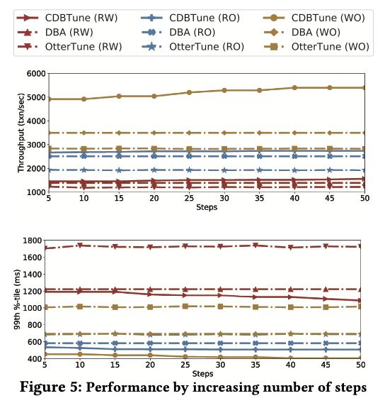
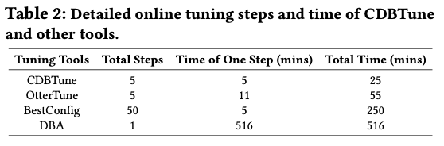
Efficiency Comparison
Notes:
We compare the online tuning efficiency of CDBTune with OtterTune [4], BestConfig [55] and DBA. Note that only CDBTune requires offline training. But it trains the model once and uses the model to do online tuning, while OtterTune requires to train the model for every online tuning request and BestConfig requires to do online search.
比较CDBTune与OtterTune[4]、BestConfig[55]和DBA的在线调优效率。注意，只有CDBTune需要离线训练。但它只训练一次模型，并使用模型进行在线调优，而OtterTune每一次在线调优请求都需要训练模型，BestConfig需要进行在线搜索。
As shown in Table 2, for each tuning request, OtterTune takes 55 minutes, BestConfig takes about 250 minutes, DBAs take 8.6 hours, while CDBTune takes 25 minutes. Note that we invite 3 DBAs to tune the parameters and select the best performance of their results which take 8.6 hours for each tuning request. (We have recorded 57 tuning requesters from 3 DBAs, which totally took 491 hours.) It takes DBA about 2 hours to constantly execute workload replay and detect the factors (e.g., analyzing the most time-consuming functions in the source code, then locating the reason, and finding the corresponding knobs to tune) that affect the performance of DBMS.
如表2所示，每次调优请求，OtterTune需要55分钟，BestConfig需要约250分钟，DBA需要8.6小时，而CDBTune需要25分钟。需要注意的是，我们邀请3个DBA对参数进行调优，并选择其结果的最佳表现，每个调优请求需要8.6小时。(我们记录了3个DBA的57个调优请求，总共花费了491个小时)。DBA要不断执行工作负载重放，检测影响DBMS性能的因素（如分析源代码中最耗时的函数，然后定位原因，找到相应的旋钮进行调优），大约需要2小时。
This process usually requires rich experience and a lot of time cost. OtterTune adopts simple GP regression, and the knobs recommended are not accurate. Therefore, it has to try more trials to achieve a better performance. BestConfig restarts the entire search processing whenever a new tuning request comes, and fails to utilize knowledge gained from previous tuning efforts, thus it requires a lot of trial time.
这个过程通常需要丰富的经验和大量的时间成本。OtterTune采用的是简单的GP回归，推荐的旋钮并不准确。因此，它必须尝试更多的试验才能获得更好的性能。而BestConfig每当有新的调优请求时，就会重新启动整个搜索处理过程，而且不能利用之前调优工作中获得的知识，因此需要大量的试验时间。
We carry out experiments with CDB-A on three kinds of Sysbench’s workloads respectively as shown in Figure 5, where the horizontal coordinate represents the number of tuning steps before recommending configurations while the vertical ordinate represents the value of throughput or latency. It is obvious that the standard model gradually adapts to the current workload through fine- tuning operations as the number of steps increases, which brings continuous improvement to the performance.
用CDB-A分别对Sysbench的三种工作负载进行了实验，如图5所示，其中横坐标代表推荐配置前的调优步数，纵坐标代表吞吐量或延迟值。很明显，随着步数的增加，标准模型通过微调操作逐渐适应当前的工作负载，从而给性能带来持续的提升。
Also, compared with OtterTune and DBA, CDBTune has already achieved a better result in the first 5 steps in all cases, indicating that our model owns high efficiency, so we believe our algorithm really draws lessons from past experience and performs excellently. Certainly, the user will get better configurations to achieve higher performance if accepting a longer tuning time. However, OtterTune keeps stable with the increasing number of iterations, which is caused by the characteristics of supervised learning and regression.
另外，与OtterTune和DBA相比，CDBTune在前5步都已经取得了较好的效果，说明模型拥有较高的效率，所以可以相信算法确实吸取了过去的经验，表现出色。当然，如果接受较长的调优时间，用户会得到更好的配置，以达到更高的性能。

Slide 24
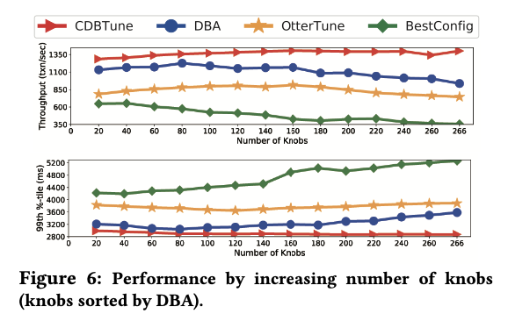
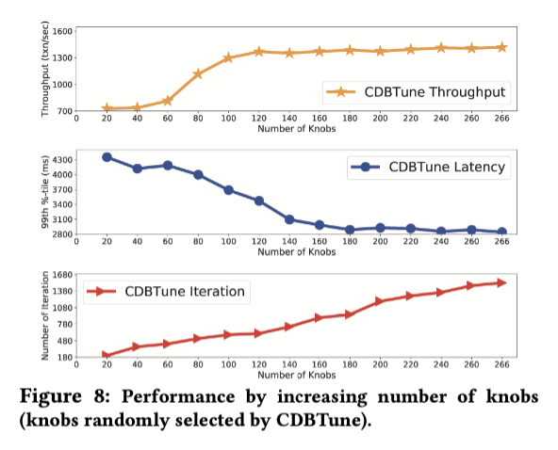
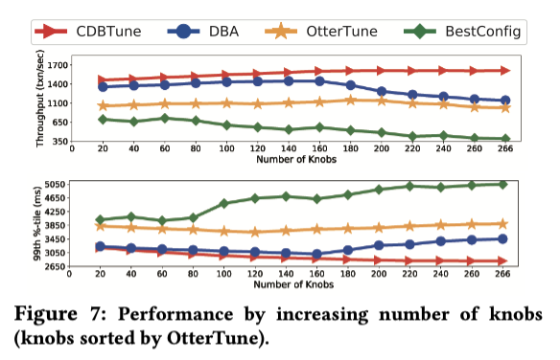
Effectiveness Comparison
Notes:
In this section, we evaluate the effect on different number of knobs and discuss the performance of CDBTune, DBA, OtterTune and Bestconfig with different workloads. With the database instance CDB-B, we record the throughput, latency, and number of iterations for TPC-C workload when the model converges.
在本节中，我们评估了不同数量旋钮的效果，并讨论了CDBTune、DBA、OtterTune和Bestconfig在不同工作负载下的性能。在数据库实例CDB-B的情况下，我们记录了模型收敛时TPC-C工作负载的吞吐量、延迟和迭代次数。
Both DBA and OtterTune rank the knobs based on their importance to the database performance. We use their orders to sort the 266 knobs and select different numbers of knobs fol- lowing the order to tune and compare different methods.
DBA和OtterTune都会根据旋钮对数据库性能的重要性进行排序。我们利用它们的顺序对266个旋钮进行排序，并选择不同数量的旋钮对冲，对不同的方法进行调整和比较。
Figures 6 and 7 show the performance with CDB-B under TPC-C workload based on the orders of DBA and OtterTune respectively.
We can see from the results that CDBTune can achieve better performance in all cases. Note that the perfor- mance of DBA and OtterTune begins to decrease after their recommended knobs exceed a certain number. The main reason is that the unseen dependencies between knobs be- come more complex in a larger knobs space, but DBA and OtterTune cannot recommend reasonable configurations in such high-dimensional continuous space.
图6和图7分别是基于DBA和OtterTune命令的TPC-C工作负载下使用CDB-B的性能。
从结果可以看出，CDBTune在所有情况下都能获得更好的性能。需要注意的是，当DBA和OtterTune的推荐旋钮超过一定数量后，其性能开始下降。主要原因是在更大的旋钮空间中，旋钮之间看不见的依赖关系更加复杂，但DBA和OtterTune无法在这样的高维连续空间中推荐合理的配置。
This experiment demonstrates that CDBTune is able to recommend better configurations than DBA and OtterTune in high-dimensional continuous space.
CDBTune randomly selects different numbers of knobs (note that the 40 selected knobs must contain the 20 selected knobs from the previous one) and record the performance of CDB-B under TPC-C workload after executing these configurations.
本实验证明CDBTune在高维连续空间中能够推荐比DBA和OtterTune更好的配置。
CDBTune随机选择不同数量的旋钮(注意，选择的40个旋钮必须包含前一个选择的20个旋钮)，执行这些配置后，记录CDB-B在TPC-C工作负载下的性能。
As shown in Figure 8, as the number of knobs increases from 20 to 266, the performance of configurations recommended by CDBTune is continuously improved. The performance is poor at the beginning, because a small number of selected knobs have a small impact on performance. Besides, after the number of knobs reach a certain number, the performance tends to be stable. This is also because the added knobs later will not greatly affect the performance.
如图8所示，随着旋钮数量从20个增加到266个，CDBTune推荐的配置性能不断提高。在刚开始的时候，由于选择的旋钮数量较少，对性能影响不大，所以性能较差。另外，当旋钮数量达到一定数量后，性能趋于稳定。这也是因为后来增加的旋钮不会对性能产生很大影响。
This experiment demonstrates that DBA and OtterTune separately rank the importance of knobs, but our CDBTune automatically com- plete this process (feature extraction) by deep neural network without additional ranking step (DBA and OtterTune need), which is also in line with our original intention of designing end-to-end model.
这个实验表明，DBA和OtterTune分别对旋钮的重要性进行排序，但我们的CDBTune通过深度神经网络自动完成这个过程（特征提取），而不需要额外的排序步骤（DBA和OtterTune需要），这也符合我们设计端到端模型的初衷。

Slide 25
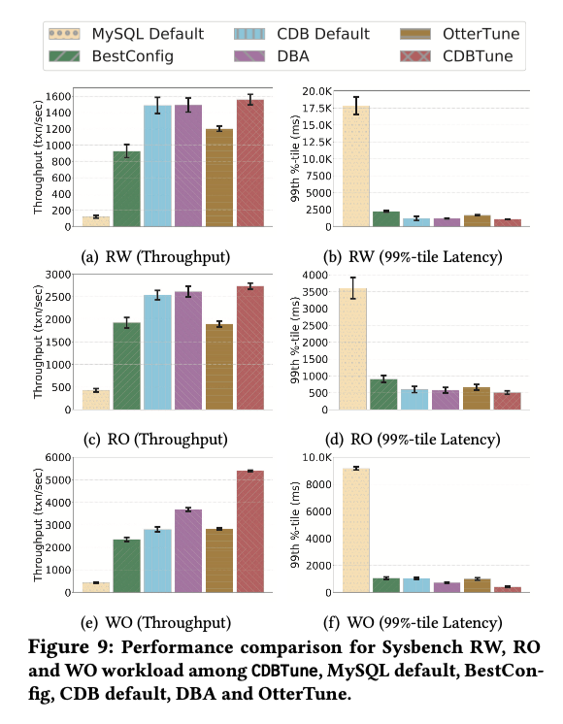
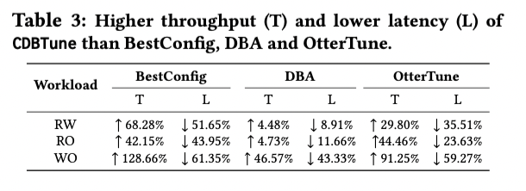
Effectiveness Comparison
Notes:
We also evaluate our method on different workloads with CDB-A and the result is shown in Figure 9.
The tuning performance improvement percentage is shown in Table 3 compared with BestConfig, DBA and OtterTune.
It can been seen that CDBTune achieves higher performance than OtterTune, which in turn is better than BestConfig. Consequently, the learning-based method is more effective and our algorithm obtains the state-of-the-art result. Compared with BestConfig, we find that CDBTune greatly outperforms it, because in a short time, BestConfig can hardly find the optimal configurations without any past experience in a high-dimensional space. This verifies that the learning-based approach has overwhelming predominance in achieving better solution quickly than search-based tuning, and also verifies the superiority of CDBTune.
本文用CDB-A在不同的工作负载上进行了评估，结果如图9所示。
与BestConfig、DBA和OtterTune的调优性能提升百分比如表3所示。
可以看出，CDBTune实现的性能高于OtterTune，而OtterTune又优于BestConfig。因此，基于学习的方法更加有效，算法获得了最先进的结果。与BestConfig相比，发现CDBTune的性能大大优于它，因为在短时间内，BestConfig很难在没有任何过去经验的情况下在高维空间中找到最优配置。这验证了基于学习的方法比基于搜索的调优方法在快速获得更好的解决方案方面具有压倒性的优势，也验证了CDBTune的优越性。

Slide 26
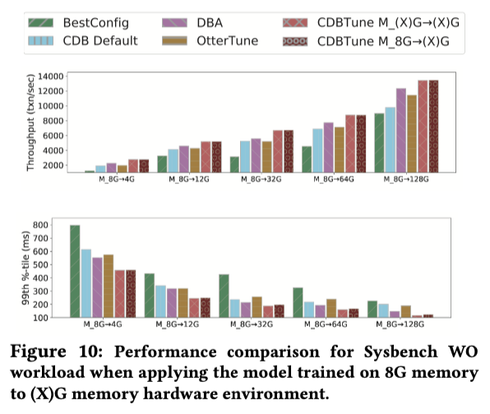
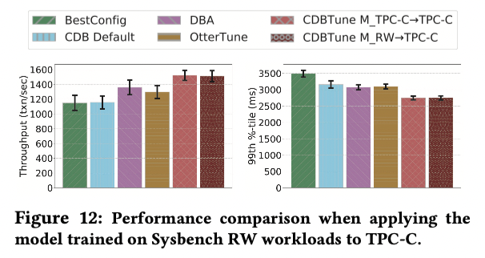
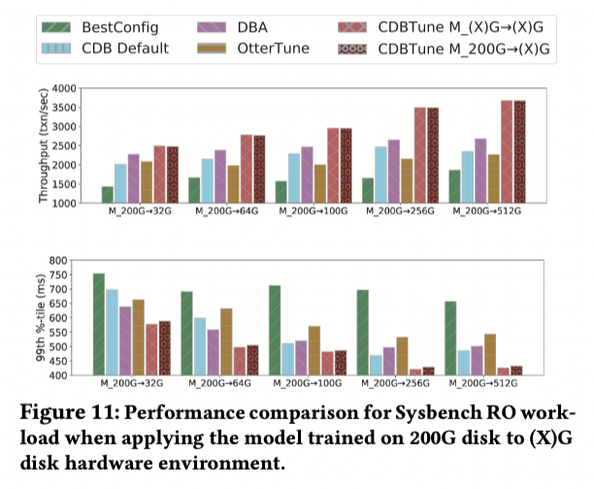
Adaptability
Notes:
We evaluate the adaptability, e.g., how a method can adapt to new environment or new workload.
接下来评估的是适应性，例如，一个方法如何适应新的环境或新的工作负载。
Compared with local self-built databases, one of the biggest advantages for cloud databases is that data migration or even downtime reloading is hardly required when resources need to be adjusted. Usually, memory size and disk capacity are the most two properties that users prefer to adjust. Thus, in the cloud environment, so many different users own their respective cloud database memory size and disk capacity that we are not able to build a corresponding model for each one. Therefore, this cloud environment naturally requires the DBMS tuning models own good adaptability.
与本地自建数据库相比，云数据库最大的一个优势是，当需要调整资源时，几乎不需要进行数据迁移甚至停机重载。通常情况下，内存大小和磁盘容量是用户最喜欢调整的两个属性。因此，在云环境中，很多不同的用户都拥有各自的云数据库内存大小和磁盘容量，我们无法为每个用户建立相应的模型。因此，这种云环境自然要求DBMS调整模型自身具有良好的适应性。
In order to verify that CDBTune can greatly optimize the database’s performance with different hardware configurations, we use database instance CDB-A (8G RAM, 100G Disk), CDB-X1 (XG RAM, 100G Disk) where X is selected from (4, 12, 32, 64, 128), CDB-C (12G RAM, 200G Disk) and CDB-X2 (12G RAM, XG Disk) where X is selected from (32, 64, 100, 256, 512). Note that there is only a different memory size between CDB-A and CDB-X1 while just a disk capacity difference between CDB-C and CDB-X2.
为了验证CDBTune在不同的硬件配置下能够极大地优化数据库的性能，我们使用数据库实例CDB-A（8G内存，100G磁盘）、CDB-X1（XG内存，100G磁盘），其中X从（4，12，32，64，128）中选择，CDB-C（12G内存，200G磁盘）和CDB-X2（12G内存，XG磁盘），其中X从（32，64，100，256，512）中选择。需要注意的是，CDB-A和CDB-X1之间只有内存大小不同，而CDB-C和CDB-X2之间只有磁盘容量不同。
For different memory size, under write-only workloads, we first directly utilize the model called M_A→X1 trained on CDB-A to recommend configurations for CDB-X1 (cross testing), then use the model called M_X1→X1 trained on CDB-X1 to recommend configurations for CDB-X1 (normal testing), and finally compare the performance after executing these two configurations. Similarly, for different disk capacity, we utilize the same way to complete cross testing and normal testing on CDB- C and CDB-X2.
对于不同的内存大小，在只写工作负载下，我们首先直接利用在CDB-A上训练的名为M_A→X1的模型为CDB-X1推荐配置（交叉测试），然后利用在CDB-X1上训练的名为M_X1→X1的模型为CDB-X1推荐配置（正常测试），最后比较执行这两个配置后的性能。同样，对于不同的磁盘容量，我们利用同样的方式在CDB- C和CDB-X2上完成交叉测试和正常测试。
As shown in Figure 10 and Figure 11, the cross-testing model almost achieves the same performance as normal-testing model. Moreover, both of above two models achieve better performance than OtterTune, BestConfig and the DBAs employed by Tencent’s cloud database, indicating that our CDBTune does not need to establish a new model and owns a strong adaptability that can completely adapt to a new hardware environment no matter how memory size, disk capacity of users change.
如图10和图11所示，交叉测试模型几乎达到了与正常测试模型相同的性能。而且，以上两种模型都取得了比OtterTune、BestConfig和腾讯云数据库采用的DBA更好的性能，说明我们的CDBTune不需要建立新的模型，拥有很强的适应性，无论用户的内存大小、磁盘容量如何变化，都能完全适应新的硬件环境。
With database instance CDB-C, we utilize the model called M_TPC-C→TPC-C trained on TPC-C workload to recommend configurations for TPC-C workload (nor- mal testing) as well as use the model called M_RW→TPC-C trained on the read-write workload contained in Sysbench to recommend configurations for TPC-C workload (cross testing).
对于数据库实例CDB-C，利用在TPC-C工作负载上训练的名为M_TPC-C→TPC-C的模型来推荐TPC-C工作负载的配置(nor- mal测试)，同时利用在Sysbench中包含的读写工作负载上训练的名为M_RW→TPC-C的模型来推荐TPC-C工作负载的配置(交叉测试)。
After deploying these two configurations recommended by CDBTune on CDB, we record their respective performance in the last two bars as shown in Figure 12. Also, the tuning performance of cross-testing model is slightly different from that of normal-testing model. That indicates that our CDBTune does not need to establish a new model and owns a good adaptability when the workload changes slightly.
将CDBTune推荐的这两种配置部署在CDB上后，将它们各自的性能记录在最后两个小节中，如图12所示。另外，交叉测试模型的调优性能与正常测试模型的调优性能略有不同。这说明CDBTune不需要建立新的模型，当工作负载稍有变化时，拥有良好的适应性。

Slide 27
CONCLUSION
Notes:
最后总结一下本文贡献

Slide 28
Contributions of this Paper
The first end-to-end automatic database tuning system that uses deep RL to learn and recommend configurations for databases
Adopt a try-and-error manner in RL to learn the best knob settings with a limited number of samples
Design an effective reward function in RL, which enables an end-to-end tuning system, accelerates the convergence speed of our model, and improves tuning efficiency
CDBTune utilizes the deep deterministic policy gradient method to find the optimal configurations in high-dimensional continuous space
Experimental results demonstrate that CDBTune with a good adaptability could recommend knobs settings that greatly improved
Notes:
在本文中，做出了以下贡献。
(1) 这是第一个使用深度RL学习和推荐数据库配置的端到端数据库自动调优系统。
(2) 在RL中采用试错的方式，在有限的样本数量下学习最佳的旋钮设置。
(3) 在RL中设计了有效的奖励函数，实现了端到端的调优系统，加快了模型的收敛速度，提高了调优效率。
(4)CDBTune利用深度确定性策略梯度法在高维连续空间中寻找最优配置。
(5)实验结果表明，CDBTune具有良好的适应性，可以推荐旋钮设置，与最先进的调优工具和DBA专家相比，大大提高了性能

Slide 29
Thanks !
Notes:
以上是此次报告的全部内容，谢谢

